Slide 1
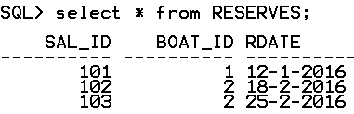

Problem to solve
Consider three tables
SAILORS(Sal_ID, SalName, Rating, Age)
RESERVES(Sal_ID , Boat-ID, Rdate)
BOATS(Boat-ID, BoatName, Color)
Write Relational Algebra express for the following
Find all the names of Sailors who have reserved boat with ID 2
temp1 <- σ_{Boat_ID=2} ^{(RESERVES)}
temp2 <- 𝞹_{SAL_ID}(temp1)
SELECT SAIL_ID
FROM RESERVES
WHERE Boat_ID = 2;
temp2

Slide 2
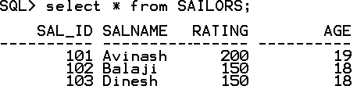

Problem to solve
i. Find all the names of Sailors who have reserved boat with ID 2
temp1 <- σ_{Boat_ID=2} ^{(RESERVES)}
temp2 <- 𝞹_{SAL_ID}(temp1)
temp3 <- SAILORS ⋈ SAILORS.Sal_ID=temp2.Sal_ID (temp2)
SELECT *
FROM SAILORS
NATURAL JOIN
(SELECT SAL_ID
FROM RESERVES
WHERE Boat_ID = 2);
temp3

Slide 3

Problem to solve
i. Find all the names of Sailors who have reserved boat with ID 2
temp1 <- σ_{Boat_ID=2} ^{(RESERVES)}
temp2 <- 𝞹_{SAL_ID}(temp1)
temp3 <- SAILORS ⋈ SAILORS.Sal_ID=temp2.Sal_ID (temp2)
result <- 𝞹_{SAL_Name}^{(temp3)}
result
SELECT SalName
FROM SAILORS
NATURAL JOIN
(SELECT SAL_ID
FROM RESERVES
WHERE Boat_ID = 2);

Slide 4
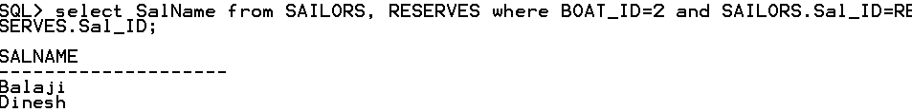
Problem to solve
i. Find all the names of Sailors who have reserved boat with ID 2
temp1 <- σ_{Boat_ID=2} ^{(RESERVES)}
temp2 <- 𝞹_{SAL_ID}(temp1)
temp3 <- SAILORS ⋈ SAILORS.Sal_ID=temp2.Sal_ID (temp2)
result <- 𝞹_{SAL_Name}^{(temp3)}

Slide 5
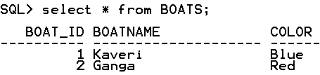
SAILORS(Sal_ID, SalName, Rating, Age), RESERVES(Sal_ID , Boat-ID, Rdate), BOATS(Boat-ID, BoatName, Color)
Write Relational Algebra express for the following
ii. Find names of sailors who have reserved RED boat
OUTPUT
--------
Balaji
Dinesh

Slide 6
SAILORS(Sal_ID, SalName, Rating, Age), RESERVES(Sal_ID , Boat-ID, Rdate), BOATS(Boat-ID, BoatName, Color)
Write Relational Algebra express for the following
ii. Find the colors of the boat reserved by Avinash
OUTPUT
--------
Red

Slide 7
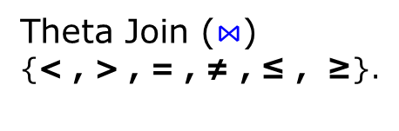

Join Operations
Join
Inner Join
Outer Join
Left Outer Join ⟕
Right Outer Join ⟖
Natural Join(*) (common attribute
names and domain
should exist between
two tables)
Full Outer Join ⟗

Slide 8

Left Outer Join ⟕
result <- table1 ⟕ table2
table1
table2
result
ID | M
1 | a
2 | b
4 | c
ID | N
2 | p
3 | q
5 | r
ID | M | ID | N
2 | b | 2 | P
1 | a
4 | c

Slide 9

Right Outer Join ⟖
result <- table1 ⟖ table2
table1
table2
result
ID | M
1 | a
2 | b
4 | c
ID | N
2 | p
3 | q
5 | r
ID | M | ID | N
2 | b | 2 | P
 |  | 3 | q
 |  | 5 | r

Slide 10

Full Outer Join ⟗
result <- table1 ⟗ table2
table1
table2
result
ID | M
1 | a
2 | b
4 | c
ID | N
2 | p
3 | q
5 | r
ID | M | ID | N
2 | b | 2 | p
 |  | 3 | q
 |  | 5 | r
1 | a
4 | c

Slide 11
Relational Algebra Set Operations - semantics
Consider two relations R and S.
UNION of R and S the union of two relations is a relation that includes all the tuples that are either in R or in S or in both R and S. Duplicate tuples are eliminated.
INTERSECTION of R and S the intersection of R and S is a relation that includes all tuples that are both in R and S.
DIFFERENCE of R and S the difference of R and S is the relation that contains all the tuples that are in R but that are not in S.
For set operations to function correctly the relations R and S must be union compatible. Two relations are union compatible if
they have the same number of attributes
the domain of each attribute in column order is the same in both R and S.

Slide 12
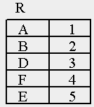
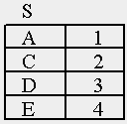
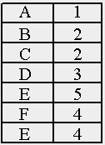
Set Operation – Union ∪
result
result <- R U S

Slide 13

Set Operation – Intersection ∩
result
result <- R ∩ S

Slide 14


Set Operation – Difference –
result <- R – S
result <- S – R

Slide 15
Problem to Solve: Writing Relational Algebra Expression
Consider the following three tables
STUDENT(StudNum, StudName)
PROJECT(ProjNum, ProjArea)
ASSIGED_TO(StudNum,ProjNum)
i. Obtain student number and student name of all students who are working on both the projects having project number 75 and 81
ii. Obtain student number and student name of all those students who do not work on project number 68
iii. Obtain the student number and student name of all those students who are working on project with name “Database”
iv. Obtain student number and student name of all students other than the student with number 554 who works on atleast one project.

Slide 16
Problem to Solve: Writing Relational Algebra Expression
Consider the following three tables
STUDENT(StudNum, StudName), PROJECT(ProjNum, ProjArea), ASSIGED_TO(StudNum,ProjNum)
i. Obtain student number and student name of all students who are working on both the projects having project number 75 and 81
STUDENT
PROJECT
ASSIGNED_TO
StudNum | StudName
554 | Avinash
555 | Balaji
556 | Chandan
557 | Dinesh
558 | Harish
ProjNum | ProjArea
56 | Java
68 | Database
75 | Database
81 | Database
StudNum | Proj Num
554 | 56
555 | 68
556 | 75
556 | 81
557 | 75

Slide 17
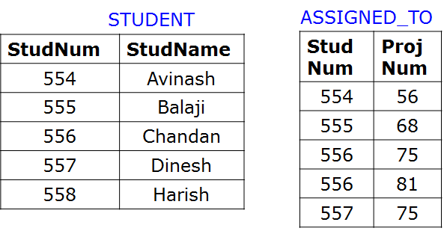
Problem to Solve: Writing Relational Algebra Expression
i. Obtain student number and student name of all students who are working on both the projects having project number 75 and 81
result
-----------------
556 Chandan

Slide 18
Problem to Solve: Writing Relational Algebra Expression
i. Obtain student number and student name of all students who are working on both the projects having project number 75 and 81
result
-----------------
556 Chandan
temp1 <- σ_{ProjNum=75}(ASSIGNED_TO)
temp2 <- 𝞹_{StudNum}(temp1)
temp3 <- σ_{ProjNum=81}(ASSIGNED_TO)
temp4 <- 𝞹_{StudNum}(temp3)
temp5 <- temp2 ∩ temp2
result <- STUDENT ⋈ _{STUDENT.StudNum=temp5.StudNum} (temp5)

Slide 19
Problem to Solve: Writing Relational Algebra Expression
ii. Obtain student number and student name of all those students who do not work on project number 68
STUDENT
ASSIGNED_TO
StudNum | StudName
554 | Avinash
555 | Balaji
556 | Chandan
557 | Dinesh
558 | Harish
StudNum | Proj Num
554 | 56
555 | 68
556 | 75
556 | 81
557 | 75
result
-----------------
Avinash
556 Chandan
557 Dinesh
558 Harish

Slide 20
Problem to Solve: Writing Relational Algebra Expression
i. Obtain student number and student name of all those students who do not work on project number 68
result
-----------------
Avinash
556 Chandan
557 Dinesh
558 Harish
temp1 <- σ_{ProjNum=68}(ASSIGNED_TO)
temp2 <- 𝞹_{StudNum}(temp1)
temp3 <- 𝞹_{StudNum}(STUDENT)
temp4 <- temp3 – temp2
result <- STUDENT ⋈ _{STUDENT.StudNum=temp4.StudNum} (temp4)

Slide 21
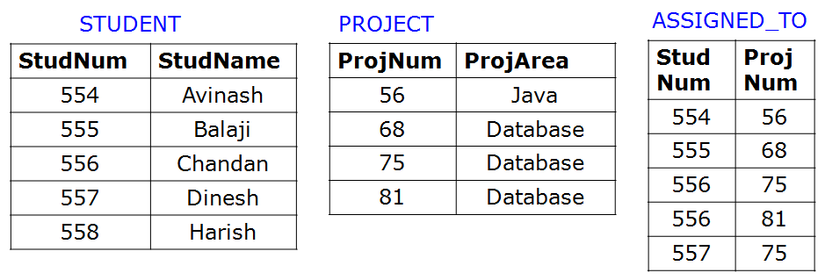
Homework Problem : Writing Relational Algebra Expression
iii. Obtain the student number and student name of all those students who are working on project with name “Database”
result
-----------------
555 Balaji
556 Chandan
557 Dinesh

Slide 22
Homework Problem: Writing Relational Algebra Expression
iv. Obtain student number and student name of all students other than the student with number 554 who works on atleast one project.
result
-----------------
555 Balaji
556 Chandan
557 Dinesh

Slide 23
Relational Algebra : Division Operation ÷
The division operator is used for queries which involve the ‘all’
qualifier such as
“Which persons have a bank account at ALL the banks in the country?”
“Which students are registered on ALL the courses given by Sonthos?”
“Which students are registered on ALL the courses that are taught in period 1?”
Find sailors who have reserved ALL boats
R ÷ S is used when we wish to express queries with “ALL”
Notes:
Attribute related to all the attributes

Slide 24
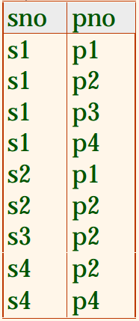
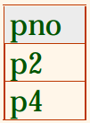

Relational Algebra : Division Operation ÷
The division operator takes as input two relations, called the dividend relation
(a on scheme A) and the divisor relation (b on scheme B) such that all the
attributes in B also appear in A and B is not empty. The output of the division
operation is a relation on scheme A with all the attributes common with B.
A
B
A ÷ B

Slide 25
Relational Algebra : Division Operation ÷
The division operator takes as input two relations, called the dividend relation
(a on scheme A) and the divisor relation (b on scheme B) such that all the
attributes in B also appear in A and B is not empty. The output of the division
operation is a relation on scheme A with all the attributes common with B.
A
B
A ÷ B

Slide 26
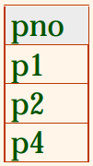

Relational Algebra : Division Operation ÷
A
A ÷ B
B

Slide 27
Relational Algebra : Division Operation ÷
Completed
DBProject
Student | Task
Feroz | Database1
Feroz | Database2
Feroz | Compiler1
Eshwar | Database1
Sara | Database1
Sara | Database2
Eshwar | Compiler1
Task
Database1
Database2
What is the Output of the following
relational Algebra Expression
Completed ÷ DBProject
Notes:
The division operator takes as input two relations, called the dividend relation (r on scheme R) and the divisor relation (s on scheme S) such that all the attributes in S also appear in R and S is not empty. The output of the division operation is a relation on scheme R with all the attributes common with S.

Slide 28
Relational Algebra : Division Operation ÷
Completed
DBProject
Completed ÷ DBProject
Student | Task
Feroz | Database1
Feroz | Database2
Feroz | Compiler1
Eshwar | Database1
Sara | Database1
Sara | Database2
Eshwar | Compiler1
Task
Database1
Database2
Student
Feroz
Sara
Notes:
The division operator takes as input two relations, called the dividend relation (r on scheme R) and the divisor relation (s on scheme S) such that all the attributes in S also appear in R and S is not empty. The output of the division operation is a relation on scheme R with all the attributes common with S.

Slide 29
Relational Algebra : Division Operation ÷
Completed
DBProject
Completed ÷ DBProject
Student | Task
F | D1
F | D2
F | C1
E | D1
E | C1
Task
D1
D2
Student
F
Is the following two relational
algebra expressions logically equivalent ?
T ← Completed ÷ DBProject
T₁ ← 𝞹_{Student}(Completed)
T₂ ← T₁ × DBProject
T₃ ← T₂ - Completed
T₄ ← 𝞹_{Student} (T₃ )
T ← T₁ - T₄
Notes:
The division operator takes as input two relations, called the dividend relation (r on scheme R) and the divisor relation (s on scheme S) such that all the attributes in S also appear in R and S is not empty. The output of the division operation is a relation on scheme R with all the attributes common with S.

Slide 30
Write relational Algebra Expresion
Find all bank customers who have account in all Branches of Bommasandra
Account
Branch
cid | branch_id | acct_no | balance
1 | 52 | 8103 | 43101.45
3 | 53 | 4826 | 752.80
1 | 53 | 7898 | 48206.10
2 | 59 | 2135 | 468923.06
1 | 59 | 1290 | 456.50
2 | 54 | 0073 | 1006.28
branch_id | branch_city
51 | Belgaum
52 | Bijapur
53 | Bommasandra
54 | Hubli
55 | Bijapur
59 | Bommasandra
Customer
cid | c_name
1 | Harish
2 | Triveni
3 | Eshwar
RESULT
c_name
Harish
Notes:
http://www.cs.montana.edu/~halla/csci440/n6/n6.html#division

Slide 31
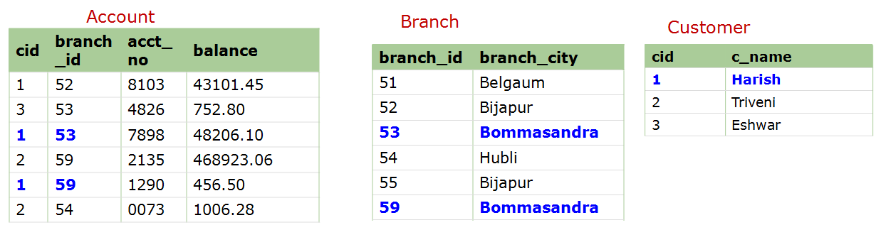
Find all bank customers who have account in all Branches in Bommasandra
BommB ← 𝞹 _{branch_id}(σ_{branch_city='Bommasandra'}(Branch)) --find all branches located
in Bommansandra
BommB
branch_id
53
59
Notes:
http://www.cs.montana.edu/~halla/csci440/n6/n6.html#division

Slide 32
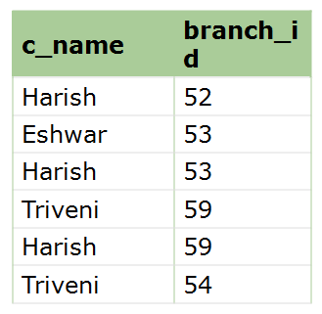
Find all bank customers who have account in all Branches in Bommasandra
BommB ← 𝞹 _{branch_id}(σ_{branch_city='Bommasandra'}(Branch)) --find all branches located
in Bommansandra
CB ← 𝞹 _{c_name,branch_id}(Customer * Account) -- find all customers' branches
BommB
CB
branch_id
53
59
Notes:
http://www.cs.montana.edu/~halla/csci440/n6/n6.html#division

Slide 33
Find all bank customers who have account in all Branches in Bommasandra
BommB ← 𝞹 _{branch_id}(σ_{branch_city='Bommasandra'}(Branch)) --find all branches located
in Bommansandra
CB ← 𝞹 _{c_name,branch_id}(Customer * Account) -- find all customers' branches
RESULT ← CB ÷ BinB -- divide to get those customers with an
account in every Bommasandra branch
BommB
CB
RESULT
branch_id
53
59
c_name
Harish
Notes:
http://www.cs.montana.edu/~halla/csci440/n6/n6.html#division

Slide 34
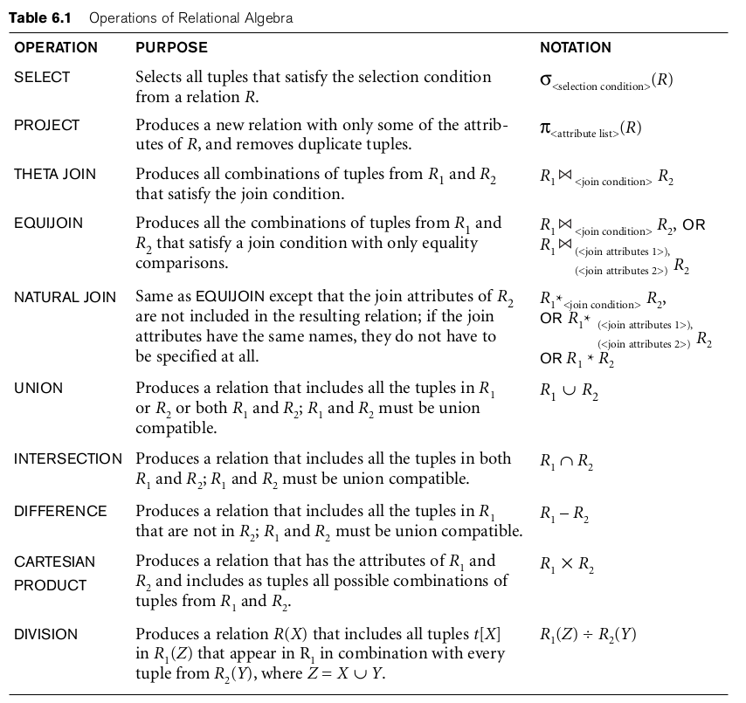

Slide 35
Query Tree Notation
Query Tree
An internal data structure to represent a query
Standard technique for estimating the work involved in executing the query, the generation of intermediate results, and the optimization of execution
Nodes stand for operations like selection, projection, join, renaming, division, ….
Leaf nodes represent base relations
A tree gives a good visual feel of the complexity of the query and the operations involved
Algebraic Query Optimization consists of rewriting the query or modifying the query tree into an equivalent tree.
Notes:
After all, it's not a query language for any DBMS. But it is useful for formal analysis of relational db operations, and as an SQL “intermediate form” for query planning and optimization.

Slide 36


Query Tree Notation: Example
Write query: For every project located in ‘Surat’, list the project number, the controlling department number, and the department manager's last name, address, and birth date.

Slide 37
Query Tree Notation: Example
Example: For every project located in ‘Surat’, list the project number, the controlling department number, and the department manager's last name, address, and birth date.
𝞹Pnumber, Dnum, Lname, Address, Bdate ((σ_{Plocation='Surat'}(Project) ⋈_{Dnum=Dnumber} Department) ⋈_{Mgr_ssn=Ssn} Employee)

Slide 38
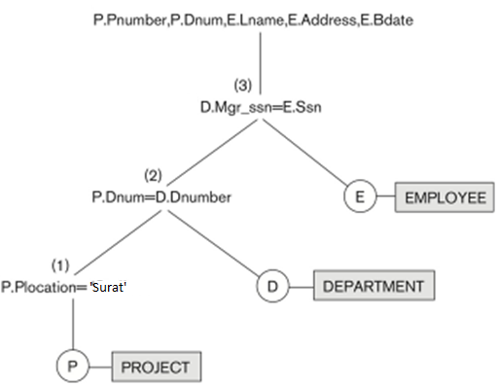
Query Tree Notation: Example
𝞹Pnumber, Dnum, Lname, Address, Bdate (
(σ_{Plocation='Surat'}(Project) ⋈_{Dnum=Dnumber} Department) ⋈_{Mgr_ssn=Ssn} Employee)
_{𝞹}
⋈
⋈
σ

Slide 39
Generalized Projection 𝞹
Extends the projection operation by allowing arithmetic functions to be used in the projection list. 𝞹 _{F1, F2, …, Fn}(E)
E is any relational-algebra expression
Each of F₁, F₂, …, F_{n} are are arithmetic expressions involving constants and attributes in the schema of E.

Slide 40
Generalized Projection 𝞹
Given relation
credit-info(CustomerName, Limit, CreditBalance)
Find how much money each person can spend:
Customer-name | Limit | CreditBalance
Avinash | 2000 | 500
Balaji | 700 | 100
Chandan | 1500 | 1000

Slide 41
Generalized Projection 𝞹
Given relation
credit-info(CustomerName, Limit, CreditBalance)
Find how much money each person can spend:
result <- ∏customer-name, (limit – credit-balance) (credit-info)
Customer-name | Limit | CreditBalance
Avinash | 2000 | 500
Balaji | 700 | 100
Chandan | 1500 | 1000
Customer-name | Limit - CreditBalance
Avinash | 1500
Balaji | 600
Chandan | 500

Slide 42
Generalized Projection 𝞹
Another Example
Consider a relation
EMPLOYEE(EMP-ID, Salary, Deduction, Years-of-Service)
A report may be required to show:
Net_salary = Salary – Deduction
Bonus = 2000 * Years-of-Service
Tax = Salary * 25%
Then a generalized projection combined with renaming may be: report _{<-} ρ_{(Net_salary, Bonus, Tax )}
(𝞹 EMP-ID, (Salary –Deduction), (2000 * Years-of-Service), (Salary * 0.25) (EMPLOYEE))

Slide 43
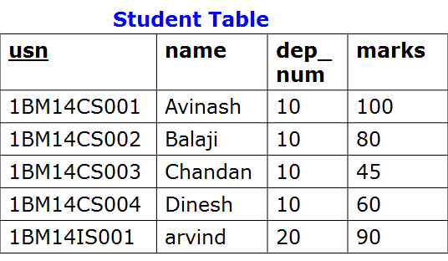
Aggregate Function ℱ (script F)
Aggregate functions return a single value, calculated from values in a column.
Useful aggregate functions:
AVG() - Returns the average value
COUNT() - Returns the number of rows
MAX() - Returns the largest value
MIN() - Returns the smallest value
SUM() - Returns the sum
ℱ_{MAX marks} (Student)
MAX_marks
-------------
100

Slide 44
Aggregate Function ℱ (script F)
ℱ_{COUNT usn, AVERAGE} _{marks}(Student)
COUNT_usn AVERAGE_marks
---------------------------------
5 75

Slide 45
Using Grouping with Aggregation
<grouping attribute> ℱ <aggregate function list>
<grouping attribute> is a list of attributes of the relation specified in R and <aggregate function list> is a list of (<function> <attribute>)
_{dep_num}ℱ_{COUNT usn, AVERAGE} _{marks}(Student)
dep-num COUNT_usn AVERAGE_marks
---------------------------------------------
10 4 71.25
20 1 90

Slide 46
Problem to Solve: Writing Relational Algebra Expression
Consider the following three tables
SALESPERSON(SalesPersonID,Name)
TRIP(SalesPersonID, From, To, Trip-ID)
EXPENSE(TripID, Amount)
i. Print the total trip expenses incurred by sales person with ID 504
ii. Give the trip details for the trip that exceeded Rs. 10,000/-
iii. Print the sales person ID and Name of the sales men who took trips to Delhi

Slide 47
Problem to Solve: Writing Relational Algebra Expression
Consider the following three tables
SALESPERSON(SalesPersonID,Name)
TRIP(SalesPersonID, From, To, Trip-ID)
EXPENSE(TripID, Amount)
SALESPERSON
EXPENSE
SalesPersonID | Name
504 | Avinash
505 | Balaji
506 | Chandan
Trip-ID | Amount
10 | 10000
11 | 8000
12 | 15000
TRIP
SalesPersonID | From | To | Trip-ID
504 | Chennai | Delhi | 10
504 | Bangalore | Bombay | 11
505 | Bangalore | Srinagar | 12

Slide 48
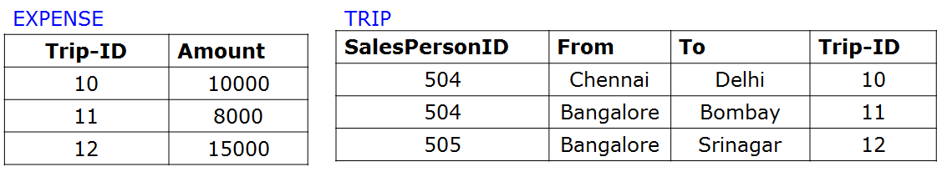
Problem to Solve: Writing Relational Algebra Expression
i. Print the total trip expenses incurred by sales person with ID 504
result
--------
18000

Slide 49
Problem to Solve: Writing Relational Algebra Expression
i. Print the total trip expenses incurred by sales person with ID 504
result
--------
18000
temp1 <- σ_{SalespersonID=504}(TRIP)
temp2 <- 𝞹_{Trip-ID}(temp1)
temp3 <- EXPENSE ⋈ _{EXPENSE.Trip-ID=temp2.Trip-ID} (temp2)
result <- ℱ_{SUM Amount} (temp3)

Slide 50
Problem to Solve: Writing Relational Algebra Expression
ii. Give the trip details for the trip that exceeded Rs. 10,000/-
result
----------------------------------------
504 Chennai Delhi 10 10000
505 Bangalore Srinagar 12 15000

Slide 51
Problem to Solve: Writing Relational Algebra Expression
ii. Give the trip details for the trip that exceeded Rs. 10,000/-
result
----------------------------------------
504 Chennai Delhi 10 10000
505 Bangalore Srinagar 12 15000
temp1 <- σ_{Amount > 10000}(EXPENSE)
result <- 𝞹 (TRIP.SalesPersonID, TRIP.From, TRIP.To, TRIP.Trip-ID,temp2.Amount) (TRIP ⋈
_{TRIP.Trip-ID=temp1.Trip-ID} (temp1))

Slide 52
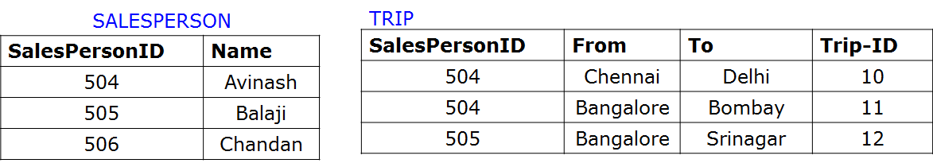
Problem to Solve: Writing Relational Algebra Expression
iii. Print the sales person ID and Name of the sales men who took trips to Delhi
result
--------------
504 Avinash

Slide 53
Problem to Solve: Writing Relational Algebra Expression
iii. Print the sales person ID and Name of the sales men who took trips to Delhi
result
--------------
504 Avinash
temp1 <- σ_{To=‘Delhi’}(TRIP)
temp2 <- 𝞹_{SalesPerson-ID}(temp1)
temp3<-SALESPERSON ⋈ SALESPERSON.SalesPersonID=temp2.SalesPerson-ID (temp2)
result <- 𝞹 _{SalesPersonID, Name} (temp3)

Slide 54
Problem to Solve: Writing Relational Algebra Expression
Consider the following relational schema describing a movie database
Schedule(Theater, Title, Time)
Movies(Title, Director, Actor)
Produced(Producer, Title)
See(Spectator, Title)
Liked(Spectator, Title)
A movie is directed by only one director but can be produced by several Producers. A spectator may like a movie without having seen it. Write the following two queries in both Relational Algebra and SQL.
Note: In relational algebra you must use the expression form and are not allowed to use linear sequence or expression trees. You are also NOT allowed renaming of relations. You may use renaming of attributes. You may use numerical comparisons (e.g. R:A > 5) in both SQL and Relational Algebra.
List the people who liked movies that they have not seen
List the producers who produced a movie that does not appear in a theater.
Notes:
https://www.cse.iitb.ac.in/~cs317/Resources/solutions/Quiz2Solutions.pdf

Slide 55
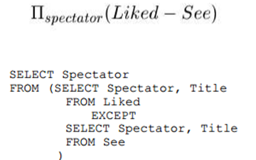
Problem to Solve: Writing Relational Algebra Expression
See(Spectator, Title)
Liked(Spectator, Title)
List the people who liked movies that they have not seen
Notes:
https://www.cse.iitb.ac.in/~cs317/Resources/solutions/Quiz2Solutions.pdf

Slide 56
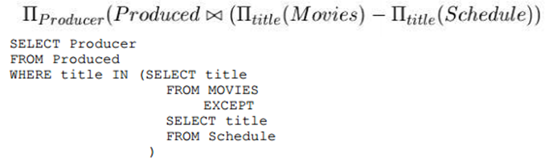
Problem to Solve: Writing Relational Algebra Expression
Schedule(Theater, Title, Time)
Movies(Title, Director, Actor)
Produced(Producer, Title)
List the producers who produced a movie that does not appear in a theater.
Notes:
https://www.cse.iitb.ac.in/~cs317/Resources/solutions/Quiz2Solutions.pdf

Slide 57
Relational Algebra Operations
Unary Operations - operate on one relation. These include select, project and rename operators.
Binary Operations - operate on pairs of relations. These include union, set difference, intersection, division, cartesian product, join, equality join, natural join, Left Outer join, Right outer join and full outer join.

Slide 58
Thank You for Your Time and Attention !
Students Should read through the
-Relational algebra example queries given in the ELMARSI and NAVATHE text book in chapter 6 of section 6.5
-Relational Model constraints and Relational database schema, Update Transactions and Dealing with constraint violation from ELMARSI and NAVATHE text book in chapter 5 of sections 5.2 and 5.3

